Slide 1
What Makes a Good Red Wine?
A data-driven look at wine quality
Ida Högquist, Data Analyst 1, Noroff

Slide 2

Background
Why this matters: Wine quality impacts customer experience and restaurant success
What was done: Analysed 1,599 red wines from a public dataset (Cortez et al., 2009)
Goal: Find out which wine features affect quality ratings (0–10 scale)

Slide 3
Analysis in Excel
1
2
3
4
Exploratory Data Analysis (EDA)
Correlation Analysis
Measured how strongly each feature is linked to wine quality.
Looked at averages, outliers and distributions for each feature.
Regression Modelling
Comparison
Tested which features best predict quality scores.
Visually compared each variable against wine ratings (0–10).

Slide 4
What Helps Wine Quality?
🍷 Alcohol has the strongest positive correlation with quality
🧪Sulphates also show a moderate positive effect
🧂Residual sugar and citric acid had little impact on quality
Simplified Correlation Matrix

Slide 5


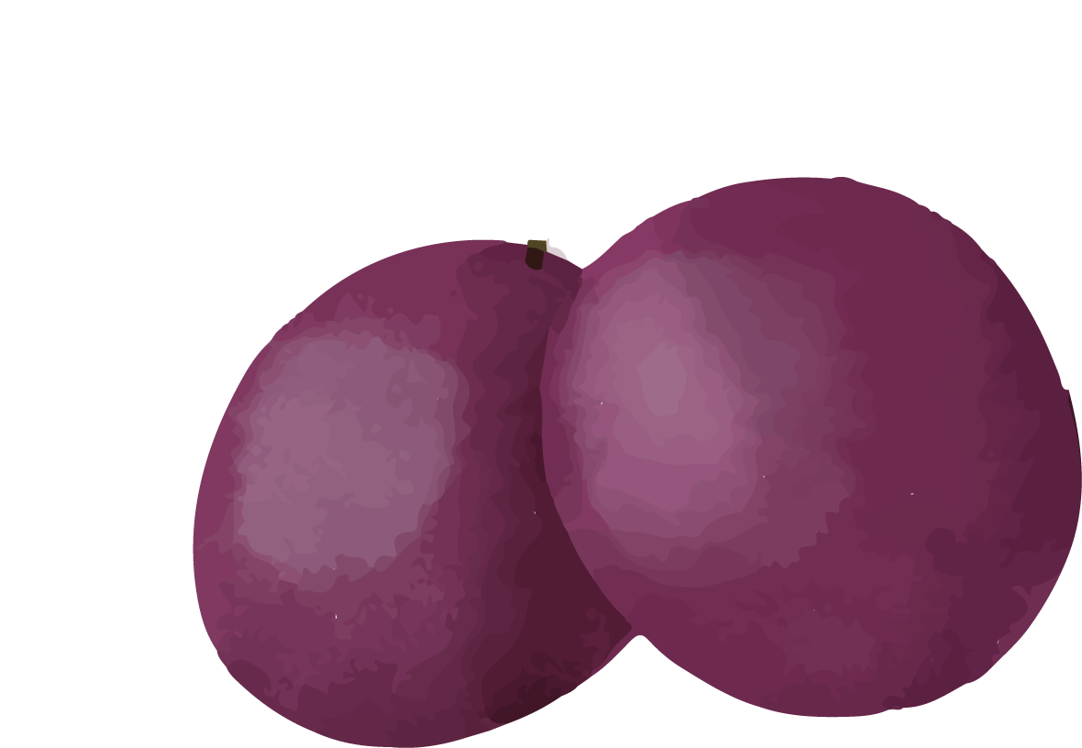
What Hurts Wine Quality?
Volatile Acidity
Too much volatile acidity gives off vinegar-like aromas, which lowers wine quality ratings

Slide 6
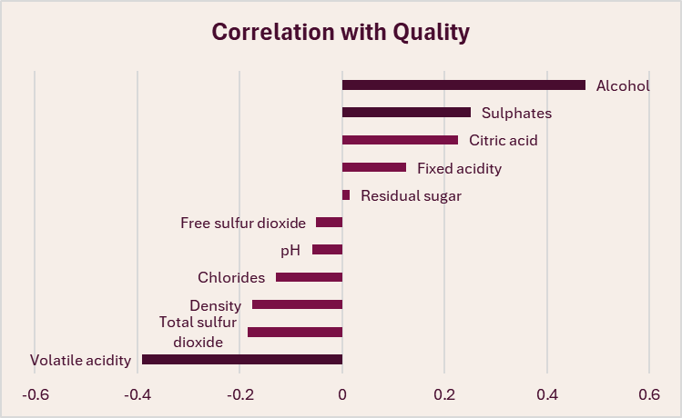
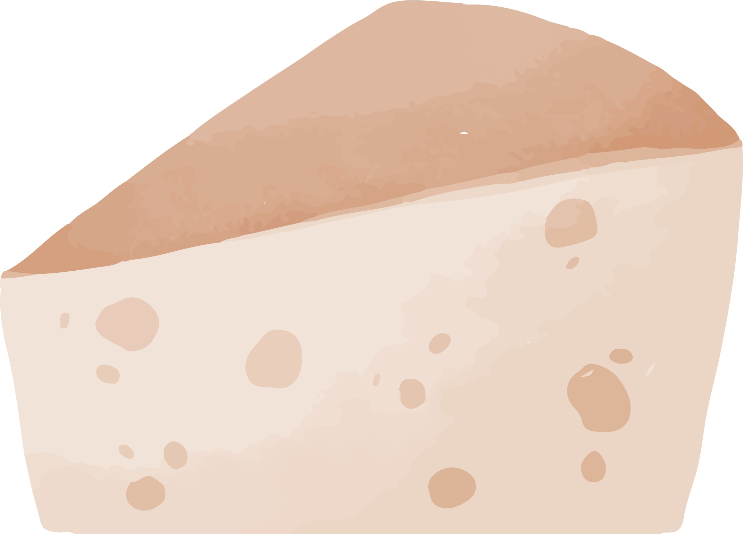
What Doesn’t Matter Much?
Citric Acid
Fixed Acidity
Residual Sugar
Free Sulphur Dioxide
pH
Chlorides
Density
Total Sulphur Dioxide
The features shown in brighter bars had little to no impact on wine quality. They can be deprioritised when selecting wines

Slide 7
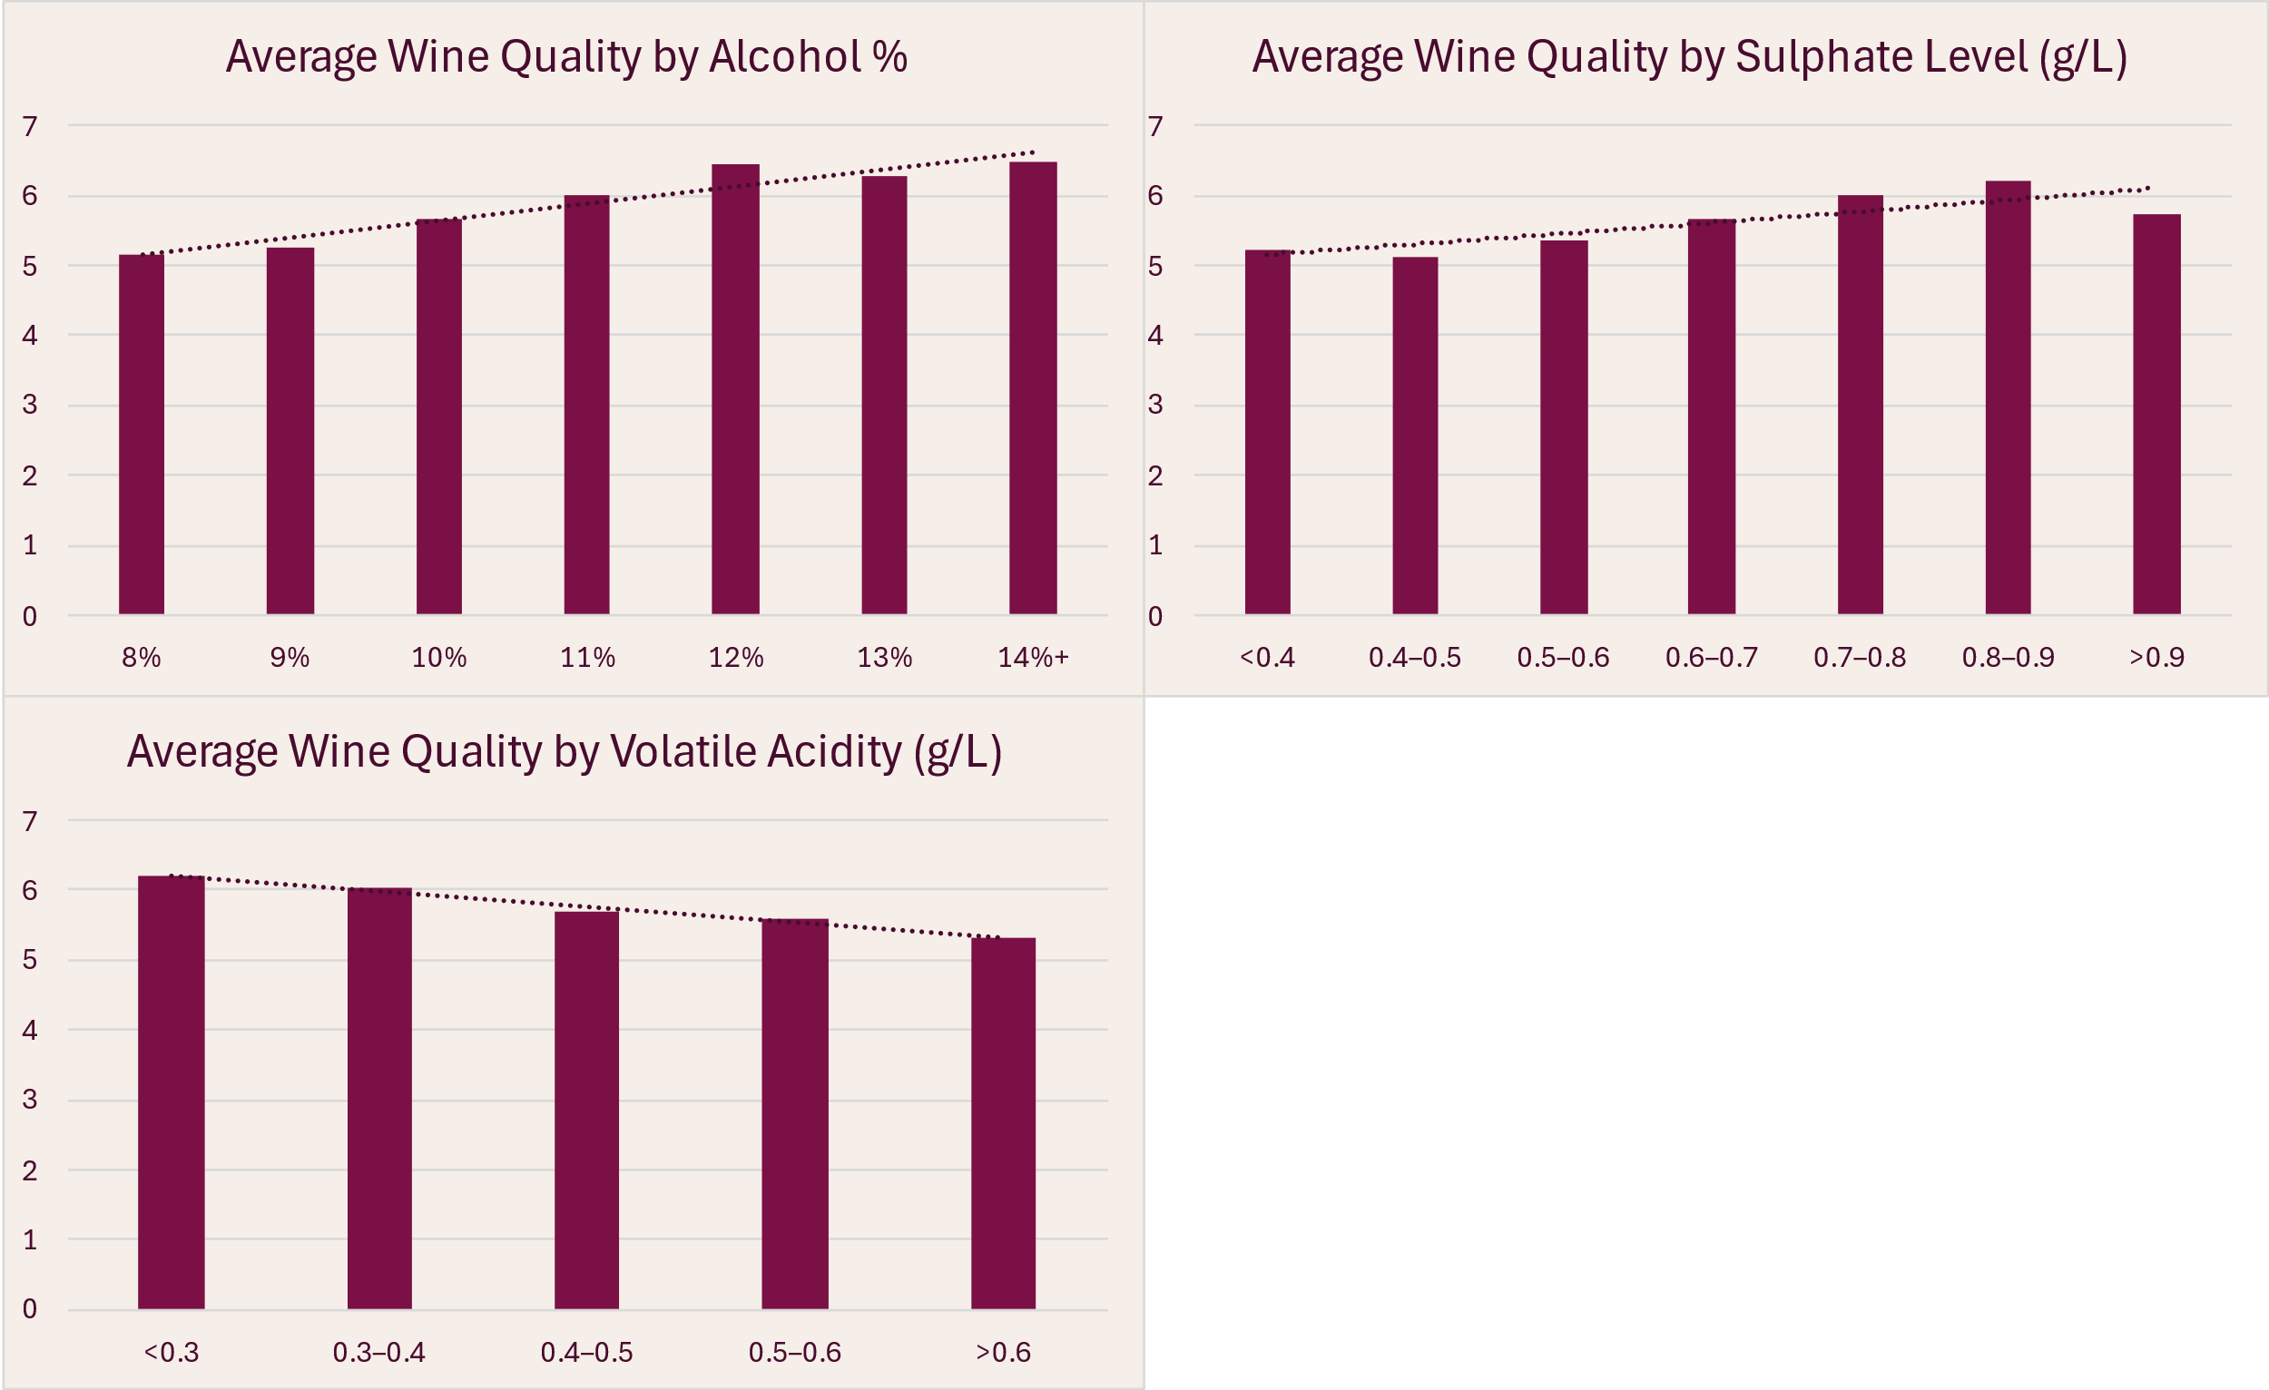


How Key Features Affect Quality
Higher alcohol and sulphates improved quality.
Higher volatile acidity lowered it.

Slide 8
Red Wine Sweet Spot
These are the ideal ranges for key features linked to higher wine quality. Staying within these “sweet spots” can help improve product selection and customer satisfaction.
Feature | Ideal Range | Warning Range | Effect on Quality
Alcohol | 11–14%✅ | <10%❌ | Higher alcohol → better quality
Sulphates | 0.7-0.9 g/L✅ | <0.5 or >0.9 g/L❌ | Higher sulphates → better quality
Volatile Acidity | <0.3 g/L✅ | >0.4 g/L❌ | Higher VA → worse quality

Slide 9
Conclusion
Wines with moderate to high alcohol levels tend to receive higher quality ratings.
Some features are less important e.g. sugar, pH and free sulphur dioxide.
High volatile acidity usually lowers wine quality, creating unpleasant smells and flavours.
Stay within the ideal ranges to keep customers satisfied with their drinks.
Sulphates help preserve wine and are positively linked to better ratings.

Slide 10
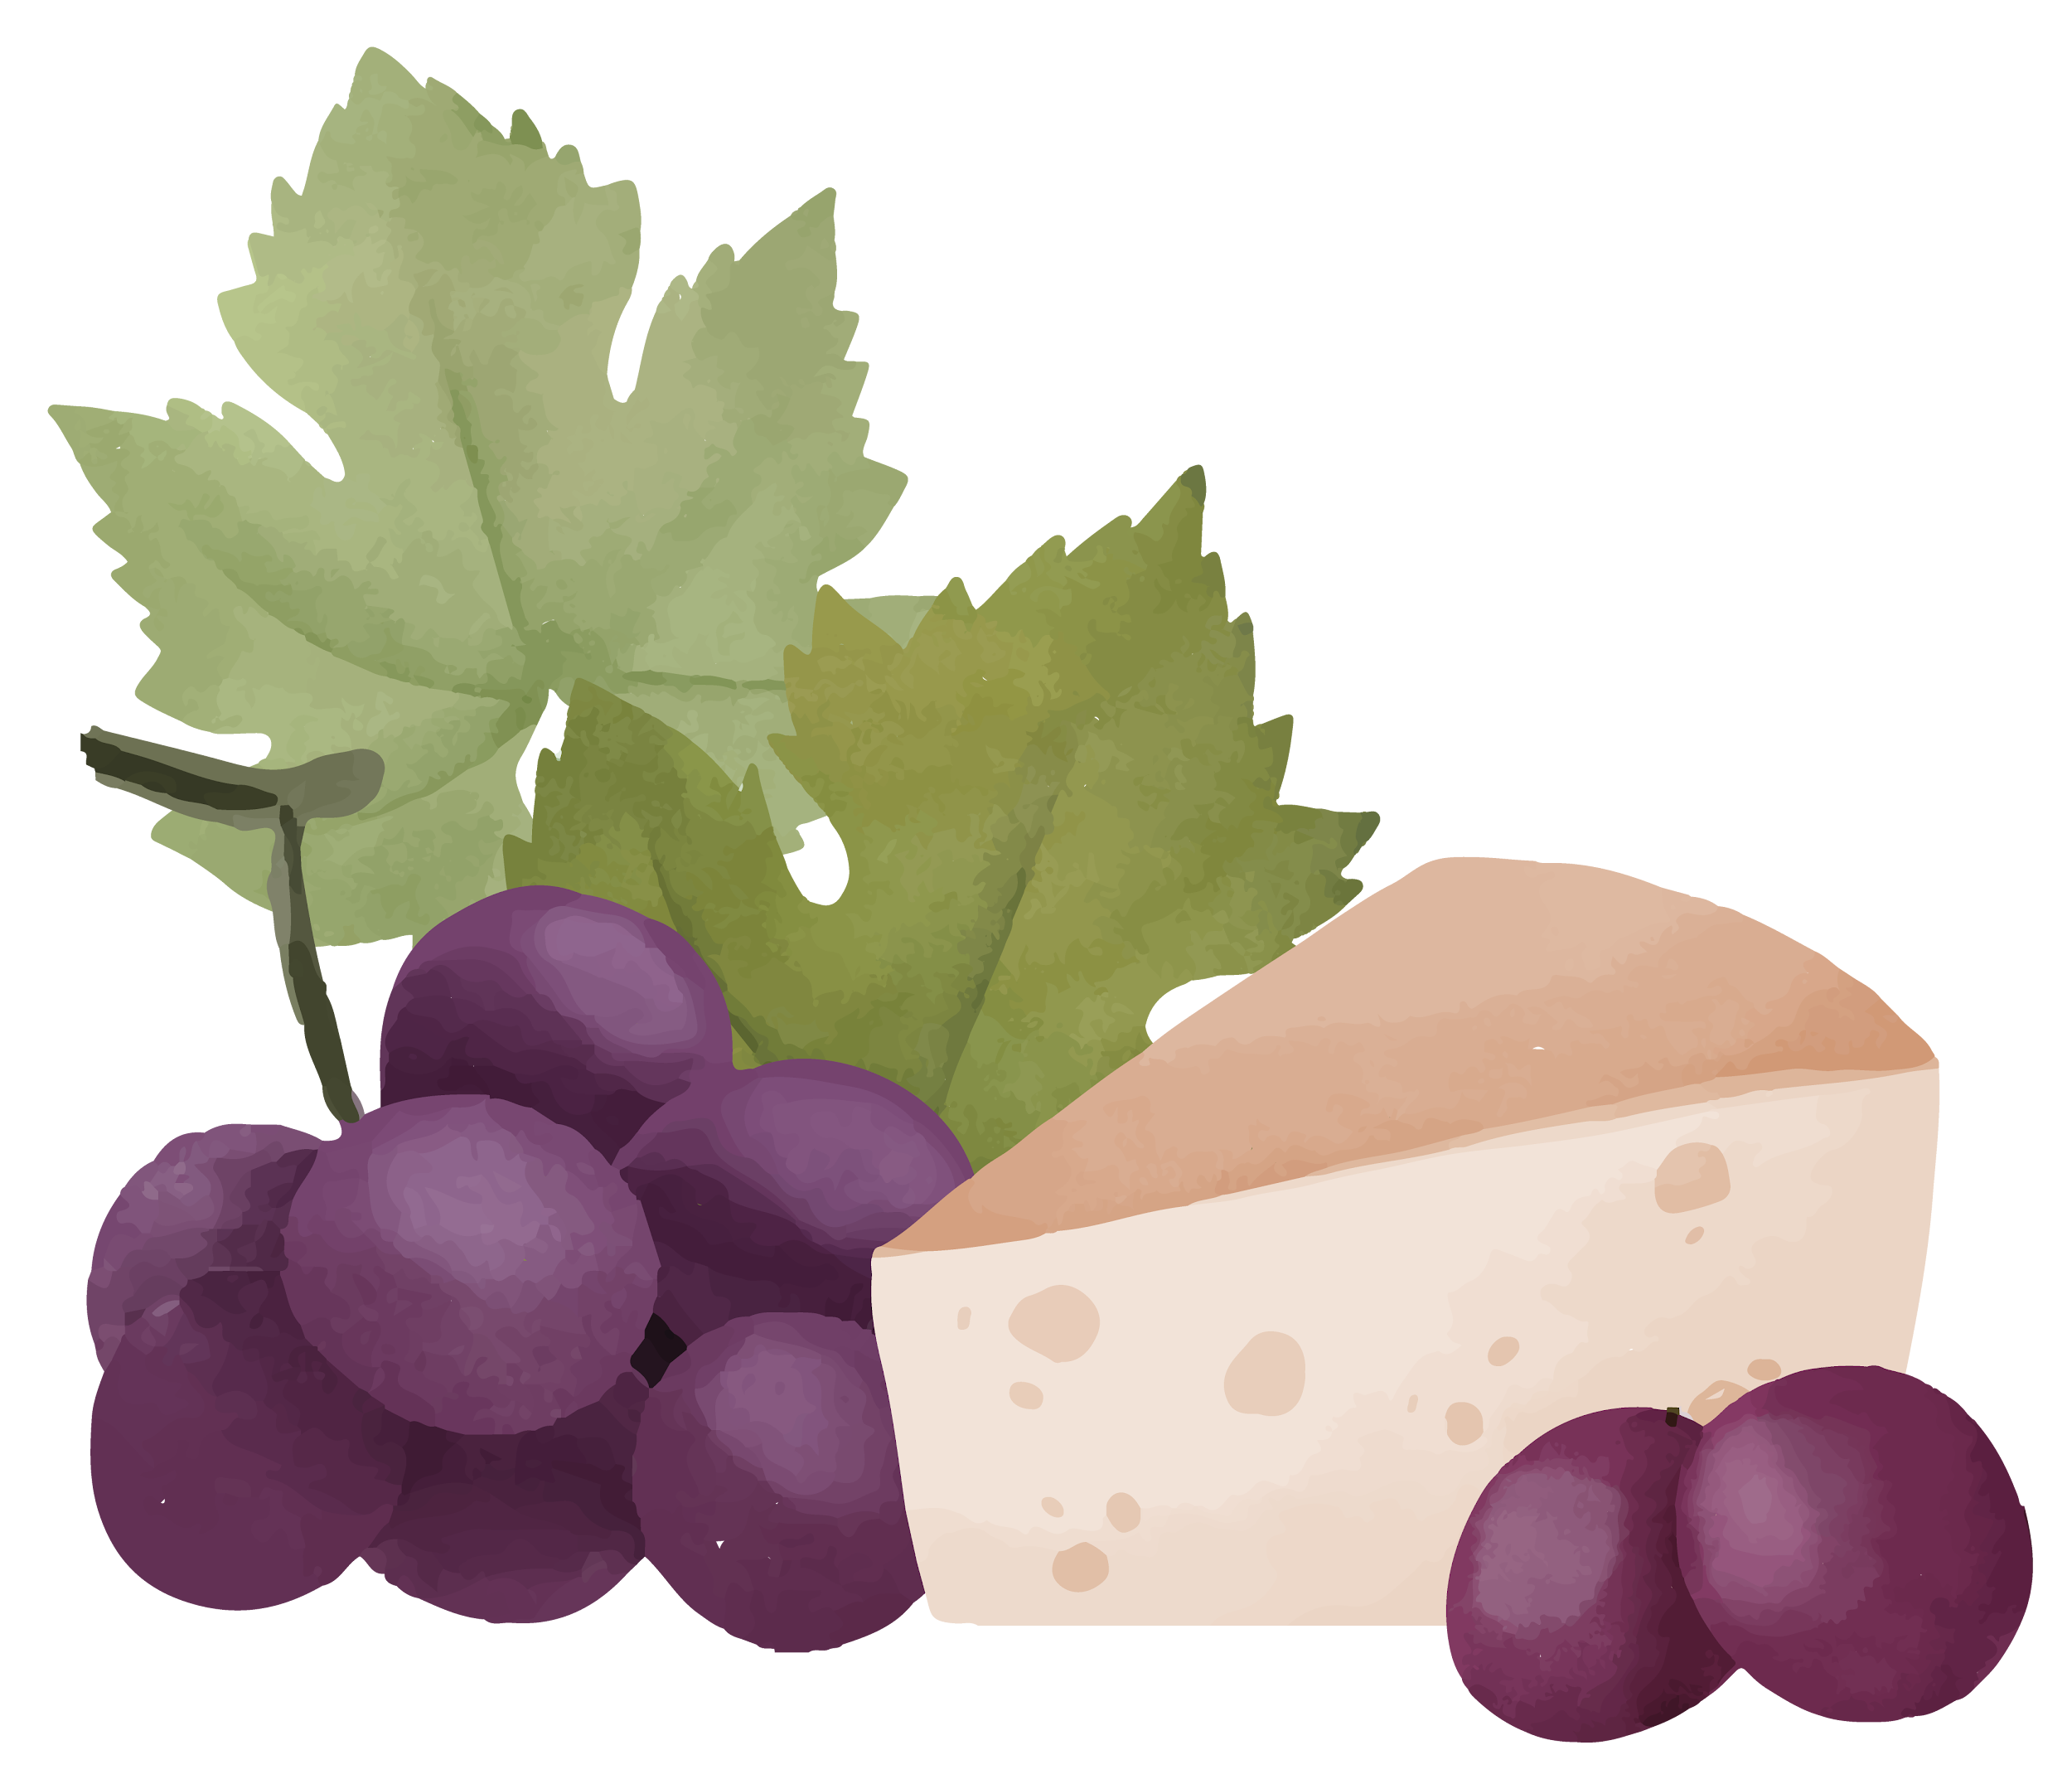
Design Thinking
Red tones inspired by wine were used to stay on theme
Wine-related icons and pictures were added to support meaning and improve looks
Key words are bolded to guide attention
Smooth animations help keep audience engaged
Charts were simplified to focus on what really matters

Slide 11
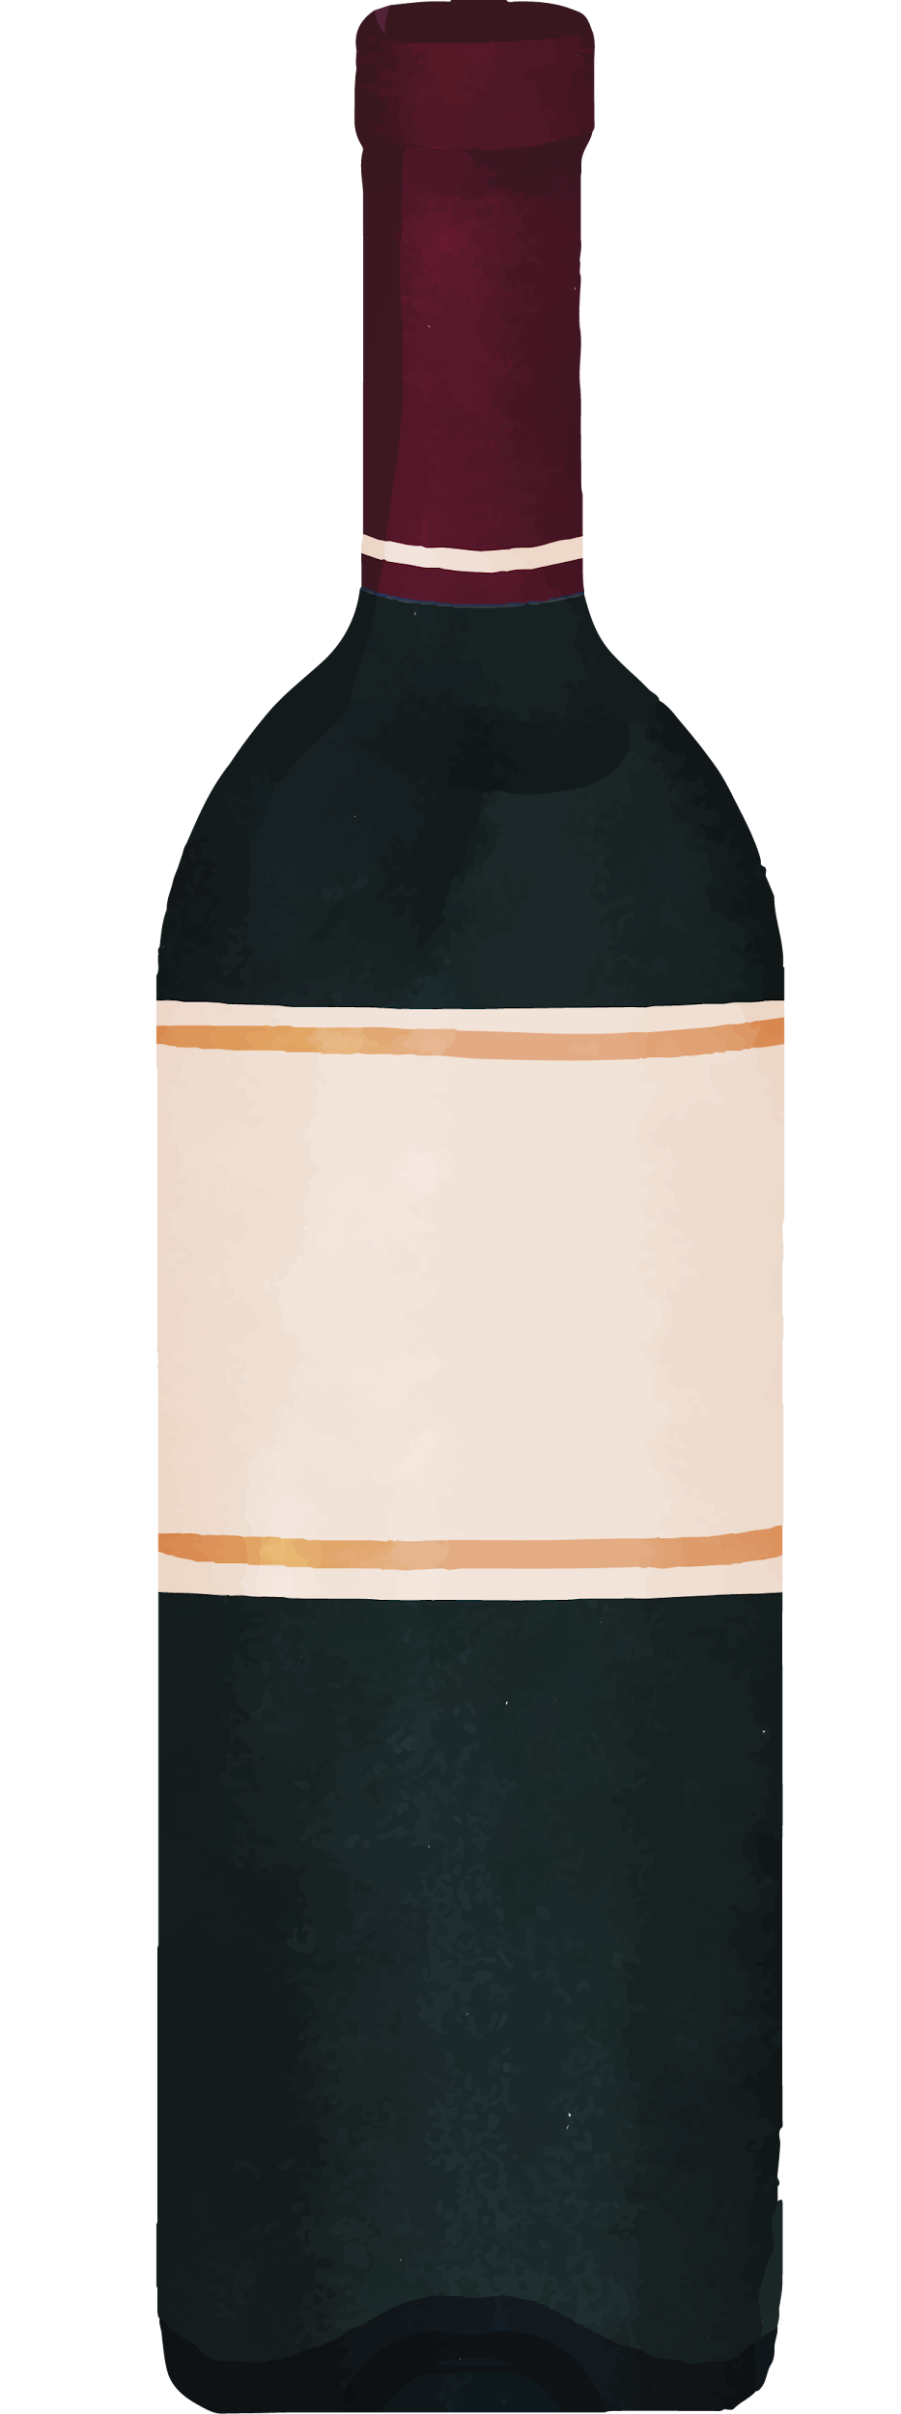
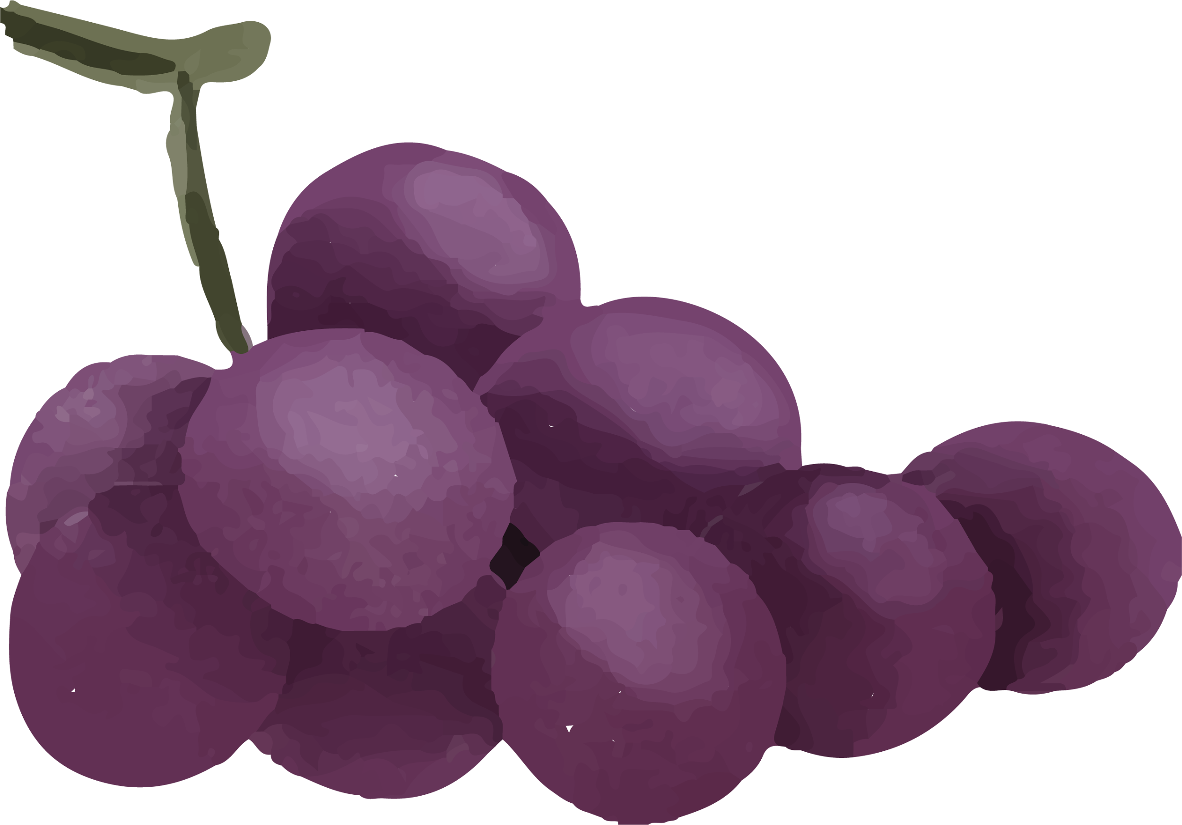
-Red Wine Quality
Thank you for your attention.
I’m happy to answer any questions you may have.
For more details, please see the full report.
Ida Högquist

